Slide 1

Expressions for suggesting

Slide 2

The following English phrases and expressions are all used to make suggestions and give advice to people.
Let’s revise our lessons.
What about going to the movies tonight?
How about playing cards?
Why don't we do our homework? (Why not do our homework?
UTN - FRVM Lic. Evangelina Cecchel - Lic. Bibiana Fernandez

Slide 3


Accepting suggestions:
Ok. Yes, let's.
Sure. / Great. / Nice.
Yes, I'd like to.
Yes, I'd love to.
What a good idea!
Why not?
Yes, with pleasure.
Yes, I feel like …
That sounds like a good idea.
That’d be great!
Refusing suggestions:
No, let's not.
No, I'd rather not.
I don't feel like it.
What an awful / bad idea!
Sorry. I can't . . . Maybe some other time.
I'd love to, but . . . I'm busy. How about Friday?
Unfortunately, . . . I have
other plans.

Slide 4

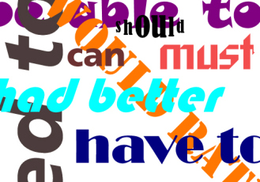

Slide 5
Modal verbs
They are auxiliary verbs that provide additional information and specific meaning to the main verb of the sentence.
Modal verbs are sometimes referred to as “modal auxiliary verbs” because they help other verbs.

Slide 6

How do we use modal verbs?
Subject + Modal + Verb
You should see a doctor.
They can dance.
I may go to the party.
They do not accept conjugation. They do not need any other auxiliary verb.
Modal verbs are followed by an infinitive without to.

Slide 7
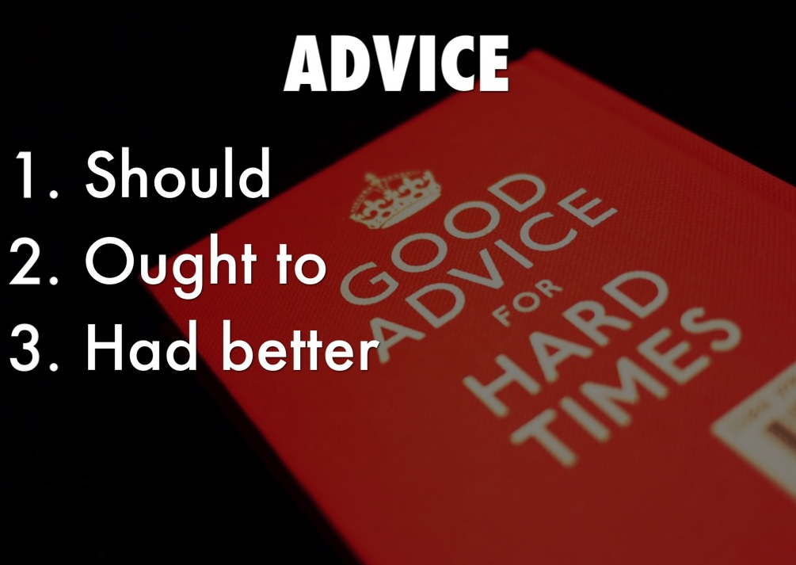

Slide 8

Should
Use “should” to give advice, recommendation or talk about what is right to do, it means “it is a good idea”:
You should obey the traffic laws!
Form: Should + base form of the verb:
Before traveling to Paris you should get a map of the city.
Use should not for the negative form:
You shouldn’t take so many suitcases.

Slide 9

Use should in the present and future tenses:
You should talk to her now before it’s too late.
You should take a different tour tomorrow.
When we want to express advice in the past with these modal verbs we follow the following structure:
Should / ought to + have + past participle of the main verb
The party was great! You should have come.
I feel terrible, I shouldn’t have eaten so much chocolate.
She didn’t pass the exam, she ought to have studied more.

Slide 10

Ought to
This modal verb has the same meaning as should:
I ought to get some insect repellent.
You ought to study for the exam.
You don’t use ought to in the negative or interrogative form, you use should in these forms.
To sound more polite use “I think” or “maybe” before “You should…” or “You ought to…”:
I think you ought to buy cheaper airline tickets.
Maybe you should leave her alone.

Slide 11

Had better – had better not
Use had better to give advice, this modal is followed by the base form of the verb, the negative form is had better not. It usually implies a warning about bad consequences:
You had better call to check your flight.
You had better not forget your passport.
I’d better phone him now.

Slide 12

I’m failing my History class!
You should get a tutor to help you.
You ought to talk to your teacher to see if you can do any extra work.
You’d better improve your grade or your parents will be very upset.

Slide 13
Should – Ought to – Had better
1. My teacher told me that I ____________ review my notes every day. I guess it's a good idea to look at them after class.
2. I'm going to a party tonight. What ___________ I wear: a dress or black pants?
3. Our car's gas tank is almost empty. We ____________ fill it up with gas soon or we will run out of gas!
4. If you are worried about getting fat, you ____________ eat at McDonald's every day. You _____________ eat healthy, low-fat foods like fruits and vegetables.
5. It's really raining outside right now. I _____________ forget my umbrella or I'll get wet!
6. Where ______________ we have lunch today: at home or in a restaurant?

Slide 14

Modals of ability
Can / Be able to / Could

Slide 15
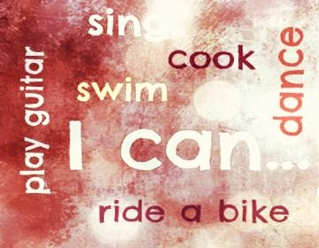
can
This modal verb describes an ability in the present tense:
I can play the guitar and sing.
Use can’t for the negative form:
Mary can ride a bike but she can’t ride a skateboard.

Slide 16

Be able to (AM/IS/ARE)
You can also use this modal verb in the present tense and, as can, it describes an ability. Though be able to is more formal than can.
She is able to speak two languages.
Use “not” after the verb “be” in the negative form:
I am able to park a car but I’m not able to drive in traffic yet.

Slide 17

could
Use this modal verb to describe an ability in the past tense:
I could play the piano when I was 11.
Use could not in the negative form:
She couldn’t write when she was 4 years old.

Slide 18
Was/were able to
Use this modal verb to describe an ability in the past tense:
There was a fire a week ago, but they were able to escape.
Use not after the verb “be” in the negative form:
She wasn’t able to swim.

Slide 19
For forms and tenses other than present and past, you have to use be able to:
We haven’t been able to play tennis for a long time. (Present Perfect)
I won’t be able to go to your house tomorrow. (Future)
I’ve always wanted to be able to play the violin. (To – infinitive)

Slide 20

Be able to / can / could
I ______________ (call) you yesterday because I was too busy.
When Martha was a teenager she _________ speak three languages.
My friend _______________ (come) to Argentina until next year.
We ___________________ (relax) more when we were younger.
She ___________________ (help) you, she has a lot of information.
When I was a child, I _______________ (play) tennis very well.
She ____________ (help) me, so I decided to ask someone else for help.
They __________ (speak) a lot of Italian, but they understand many words.
She _____________ (buy) the dress because it was too expensive.
You ___________ (speak) English well if you practice very frequently.

Slide 21


Slide 22

MODAL VERBS FOR REQUEST
Can, Could, Will & Would are modal verbs used with other verbs to make requests, that is, to ask someone to do something:
Modal + Subject + Verb
Can you help me?
Could you open the door?
Will you go to the bank for me?
Would you lend me your dictionary?

Slide 23

Use can and will for informal requests:
Can you pass me the salt? Will you turn off the radio?
Could and would are more polite, but have the same function.
Could you pass me the salt?
Would you turn off the radio?

Slide 24
These modals turn basic orders into questions. This is a much more polite way of asking for something rather than making an imperative command.
Give me the salt => Can you pass me the salt? Turn off the radio => Could you turn off the radio?
You can also use please to make a request more polite. Note the word order.
Would you please open your books?
Would you open your books, please?

Slide 25
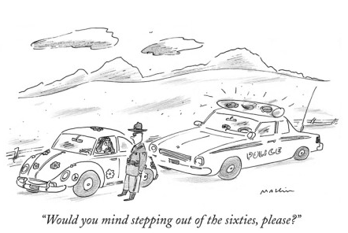
Would you mind…?
If you want to sound particularly polite, you can also use Would you mind + verb -ing? as the preferred alternative to Could you…?
Would you mind locking the door when you leave?
~ No, not at all!
Could you please lock the door when you leave?
~ Yes, certainly!

Slide 26

When we agree to a request we generally answer:
Yes, sure. (informal)
Of course. (informal)
Ok. (informal)
Uh-huh (means yes and is informal)
Certainly. (informal)
I’d be happy to. / I’d be glad to. (formal)
My pleasure. (formal)
To a “Would you mind…?” request we answer:
Not at all.
No, I don’t mind.

Slide 27
When we say “no” to a request, we usually apologize and give a reason.
Sorry, but I’m busy now.
I’m sorry, I can’t because …
I’d love to, but I can’t.
I’m so sorry but…

Slide 28

OFFERS

Slide 29
SHALL / WILL
Shall is not used very much nowadays and mostly in formal speech and some legal documents. Originally Shall was used instead of Will in first person (with I and We) when talking about the future. Now almost everyone uses will with all subjects.
Nowadays, the most common use of shall in everyday English (although not in American English) is in questions that serve as offers or suggestions: "Shall I ...?" or "Shall we ...?”
Shall I call her for you?
Will I call her for you?

Slide 30
CAN
You can use this modal verb to offer someone to do something:
I can buy the tickets if you want.
Can I help you?
MAY
You use this modal verb to express a formal offer:
May I wash the dishes?
May I get you a cup of tea?
WOULD
With this modal verb you can also offer something:
Would you like a cup of coffee?

Slide 31

MODALS
OF
POSSIBILITY

Slide 32
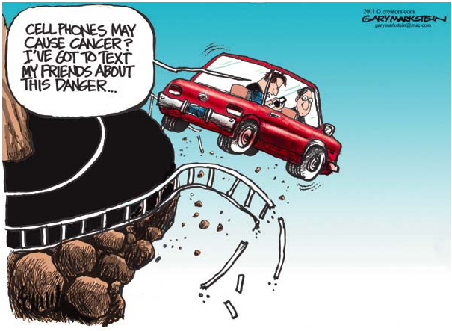
MAY
It shows possibility in the present or the future. Present: Where are my keys? They may be in the car.
Future: I may go to the party tonight.
May is formal and is often found in writing.
Side effects of this medication may include upset stomach and fever.

Slide 33

MIGHT
It shows possibility in the present or future.
Where are my keys? They might be in the car.
I might go to the party tonight.
Might is less formal than may, and is more common in conversation.

Slide 34
COULD
It shows that something is possible in the present or future.
Present: Where are my keys? They could be in the car.
Future: We could go to the party tonight.
Could shows options, or possibility.

Slide 35
MAY (MAY NOT)
She may come to the party.
She may not phone after the test.
MIGHT (MIGHT NOT)
It might be dangerous or it might not, it depends on the situation.
COULD (COULD …?)
Could he be innocent? He might be.

Slide 36


Slide 37
Advice: “Should”, “ought to”, “had better”.
http://www.ompersonal.com.ar/INTERMEDIATE/unit6/page5.htm
http://www.ompersonal.com.ar/INTERMEDIATE/unit6/page6.htm (Reading Comprehension)
Ability: “can”, “could”, “be able to”.
http://www.ompersonal.com.ar/omgrammar/can-could-beable.htm
http://www.ompersonal.com.ar/omexercise/verbosmodales/unit15.htm
Requests: “can”, “could”, “will”, “would”, “would you mind+ verb ending in -ing”.
http://www.ompersonal.com.ar/INTERMEDIATE/unit7/page2.htm
Possibility: “may”, “might”, “could”.
http://www.ompersonal.com.ar/omverbs/simplemodals.htm

